Slide 1
Lecture 12
Statistical computing: Hierarchical modeling
Bootstrap

Slide 2
library(bootstrap)
data(patch)
##theta=(E(new)-E(old))/(E(old)-E(placebo))=Ybar/Zbar
##if -0.20<=abs(theta)<=0.20
##original sample estimate
thhat<-mean(patch$y)/mean(patch$z)
#thhat
#[1] -0.0713061

Slide 3
sq<-seq(1:8)
B<-10000
n<-length(sq)
bmat<-matrix(0,B,1)
for(i in 1:B)
{s1<-sample(sq,n,replace=TRUE)
y1<-patch$y[s1]
z1<-patch$z[s1]
y1bar<-mean(y1)
z1bar<-mean(z1)
bmat[i,]<-y1bar/z1bar}
#sampling distribution of the theta statistic
hist(bmat,breaks=75,main="bootstrap distribution",xlab="theta")
summary(bmat)
V1
#Min. :-0.314443
#1st Qu.:-0.138095
#Median :-0.074362
#Mean :-0.063807
#3rd Qu.:-0.003144
#Max. : 0.576780

Slide 4
sd(bmat) #standard error of theta hat
#[1] 0.1031997
#percentile 95% confidence interval
c(quantile(bmat,0.025),quantile(bmat,0.975))
# 2.5% 97.5%
#-0.2326434 0.1674930
#percentile 90% confidence interval
c(quantile(bmat,0.05),quantile(bmat,0.95))
# 5% 95%
#-0.2135213 0.1228531
##bootstarp extimate of the bias
mean(bmat)-thhat
#[1] 0.007499607

Slide 5
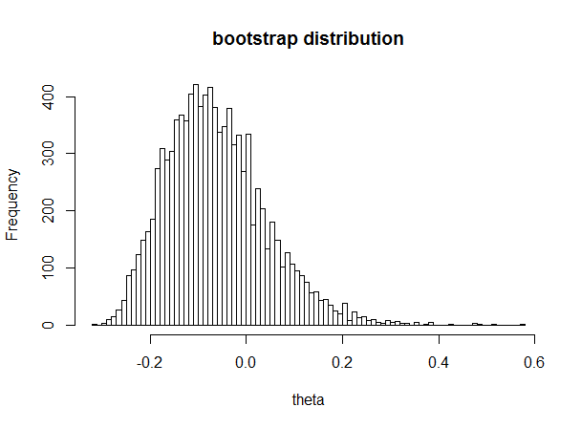

Slide 6
### BCa approach
boot.BCa <-
function(x, th0, th, Stat, conf = .90) {
# BCa confidence interval
# th0: observed statistic
# th: vector of bootstrap distribution
# stat is the function to compute the statistic
x <- as.matrix(x)
n <- nrow(x) #observations in rows
N <- 1:n
alpha <- (1 + c(-conf, conf))/2
zalpha <- qnorm(alpha)
# the bias correction factor
z0 <- qnorm(sum(th < th0) / length(th))
# the acceleration factor (jackknife est.)
th.jack <- numeric(n)
for (i in 1:n) {
J <- N[1:(n-1)]
th.jack[i] <- stat(x[-i, ], J)
}
L <- mean(th.jack) - th.jack
a <- sum(L^3)/(6 * sum(L^2)^1.5)
# BCa conf. limits
adj.alpha <- pnorm(z0 + (z0+zalpha)/(1-a*(z0+zalpha)))
limits <- quantile(th, adj.alpha, type=6)
list("est"=th0, "BCa"=limits)
}
xx<-cbind(patch$y,patch$z)
ST<-function(Data,Ind)
{mean(Data[Ind,1])/mean(Data[Ind,2])}
boot.BCa(xx,th0=thhat,th=bmat,Stat=ST)
#$est
#[1] -0.0713061
#$BCa
# 6.329337% 96.17748%
# -0.2058123 0.1402148

Slide 7
xx<-cbind(patch$y,patch$z)
ST<-function(Data,Ind)
{mean(Data[Ind,1])/mean(Data[Ind,2])}
boot.BCa(xx,th0=thhat,th=bmat,Stat=ST)
#$est
#[1] -0.0713061
#$BCa
# 6.329337% 96.17748%
# -0.2058123 0.1402148

Slide 8
## Jackknife distribution
#jackknife replicates, leave-one-out estimates
th.jack <- numeric(n)
for (i in 1:n)
th.jack[i] <- mean(patch$y[-i]) / mean(patch$z[-i])
##bootstrap after jackknife
bmatj<-matrix(0,B,1)
for(i in 1:B)
{s1<-sample(sq,n,replace=TRUE)
bmatj[i,]<-mean(th.jack[s1])}
wd<-rbind(bmat,bmatj)
typ<-c(rep('Bootstrap',B),rep("Jacknife",B))
wh<-as.data.frame(cbind(wd,typ))

Slide 9
##### EXAMPLE OF HISTOGRAMS ###############################
ggplot(wh, aes(x = wd, fill = typ)) +
geom_histogram(data = wh, fill = "grey", alpha = .5) +
geom_histogram(colour = "black") +
facet_wrap(~ typ) +
guides(fill = FALSE) + # to remove the legend
theme_bw() # for clean look overall
#### EXAMPLE OF BOXPLOTS #################################
p <- ggplot(wh, aes(factor(typ), wd))
p + geom_boxplot() + geom_jitter()
p + geom_boxplot(aes(fill = factor(typ)))
##Comparative density plots
ggplot(wh, aes(x=wd, fill=typ)) + geom_density(alpha=0.3)

Slide 10
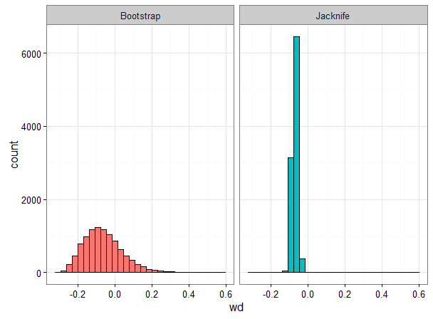

Slide 11
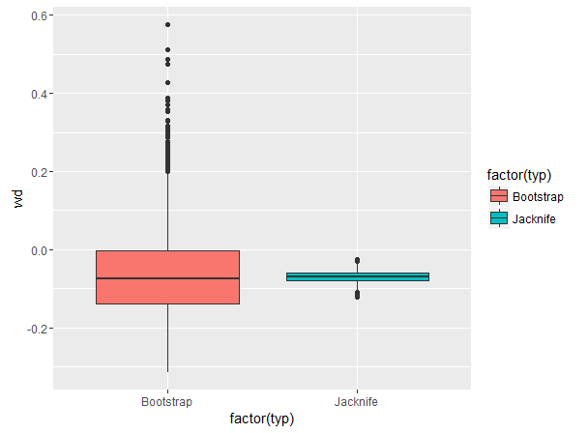

Slide 12
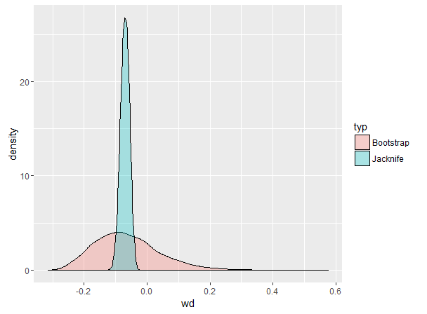

Slide 13
Readings
Efron and Tibshirani monograph about BCa confidence intervals
(uploaded on blackboard)

